Slide 1
Getting Started with STM32L5 development platform - RUTDevKit
Getting Started with RUTDevKit

Slide 2



Registration & Download
1.) The hardware, firmware examples and documentation for RUTDevkit can be downloaded from Rutronik webpage after registration is completed: https://rutronikdev.rut.local/development-stories/rutdevkit-stm32l5/
2.) Development tools CubeMX, CubeProgrammer and CubeMonitor are provided by STMicroelectronics: https://www.st.com/en/development-tools/stm32-software-development-tools.html
3.) All firmware examples initially were created using IAR Embedded Workbench IDE. The 30 days free trial version is available to download here: https://www.iar.com/iar-embedded-workbench/#!?architecture=Arm

Slide 3
Quick Launch

Slide 4

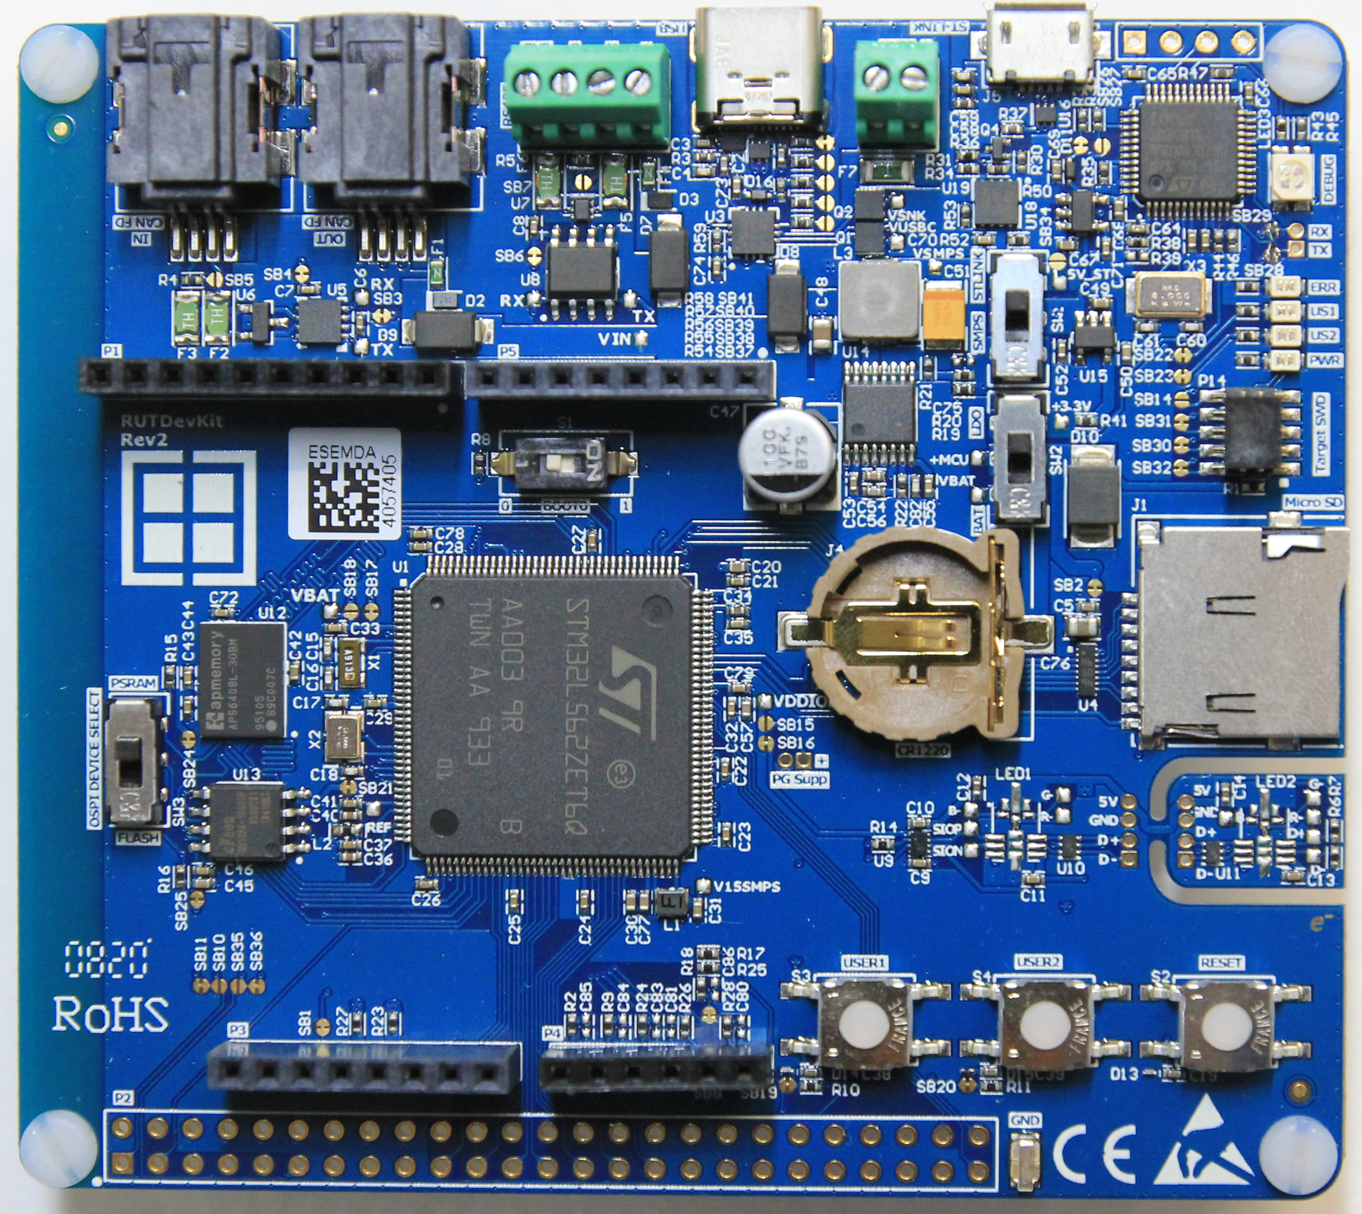
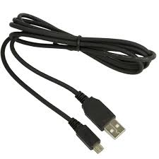
Quick Launch
1.) Connect the RUTDevKit.
Ensure the switch SW1 is set to “STLINK”
Look for socket with marking “ST-LINK”
Have Micro USB Cable - A to Micro B
Connect with PC

Slide 5
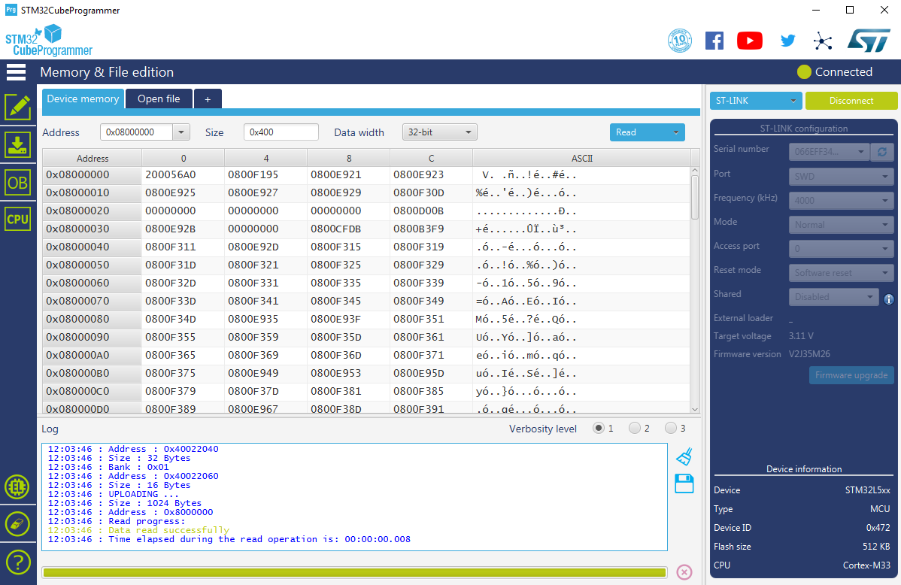
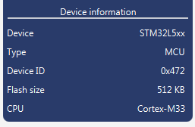
Quick Launch
2.) Launch the STM32 CubeProgrammer and access the STM32L562 MCU.
If MCU is functional, it appears as at is shown in “Device information”
Select “ST-LINK” and press “Connect”

Slide 6
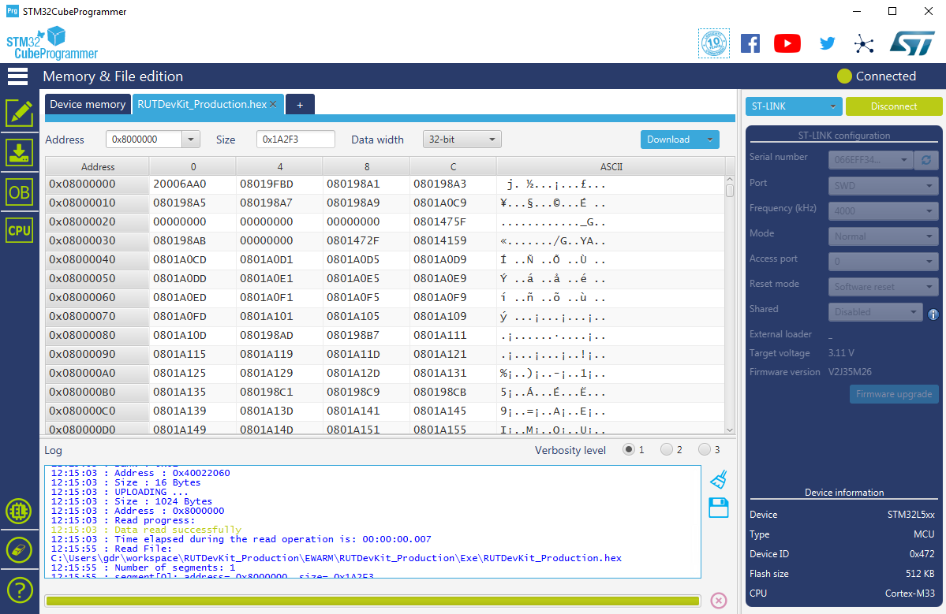
Quick Launch
3.) Program compiled project examples.
Select binary image with “Open File”
Press “Download” to program the MCU. Then press “Disconnect” and reset the board to start executing the image downloaded.
*Default demo firmware is already preprogramed in factory.

Slide 7
Running the Demo

Slide 8

Running the Demo
All new RUTDevKits comes with preprogramed firmware.
Demo firmware is used to test:
AP Memory PSRAM.
Micro SD card.
USB-C Power Delivery Sink.
CAN FD.
Arduino ADC ports.
LEDs.
Buttons.
CubeMonitor UCPD software is used to monitor trace messages sent from RUTDevKit.
Download: STM32CubeMonUCPD

Slide 9
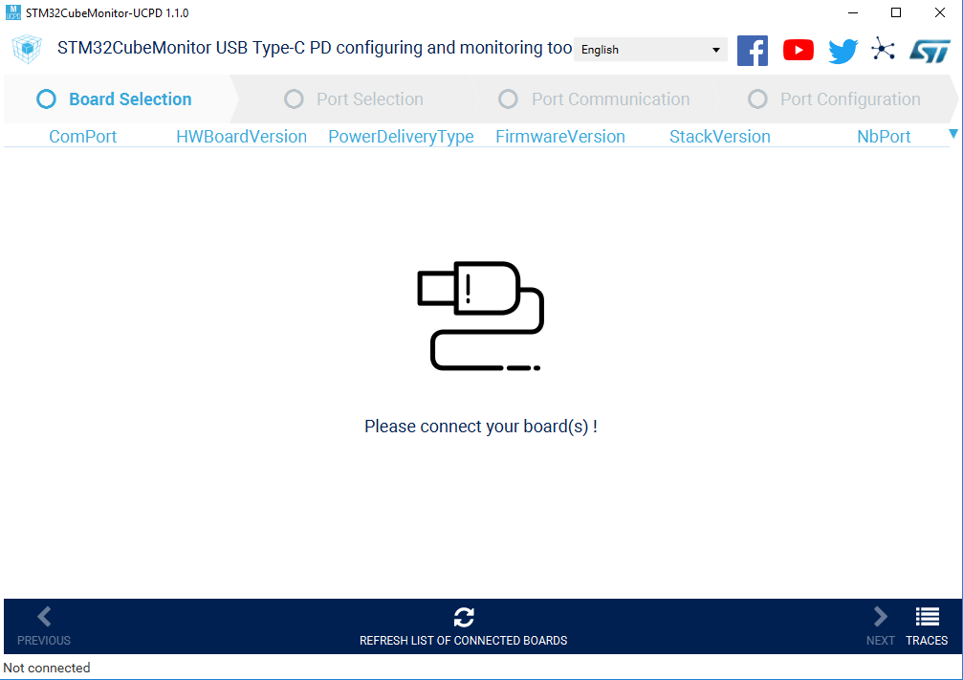
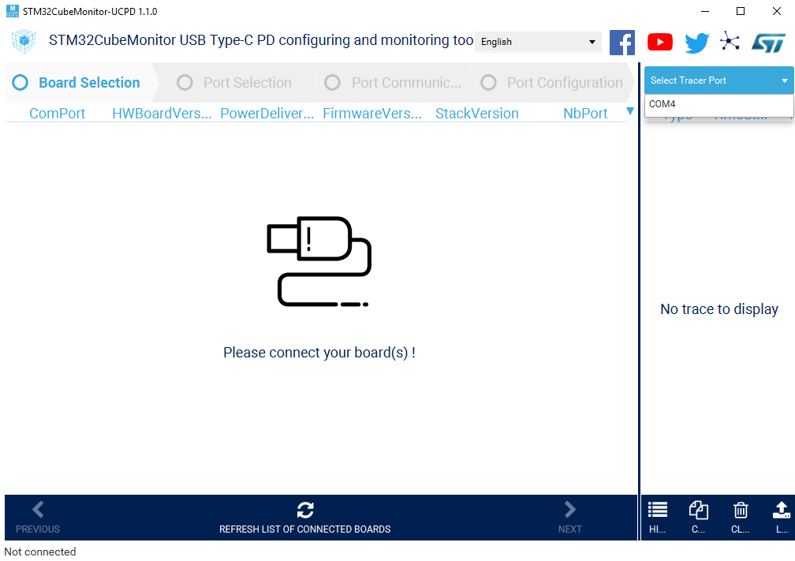
Running the Demo
1.) Install CubeMonitor UCPD software.
2.) Connect RUTDevKit to the PC.
3.) Launch the CubeMonitor UCPD.
4.) Select “TRACES” tab.
5.) Select COM Port & reset the RUTDevKit board.

Slide 10
Running the Demo
After RUTDevKit hard-reset the test procedure begins.
The Debug information is shown:
19 DEBUG 1005 2 PSRAM Test Started
20 DEBUG 4171 2 PSRAM Test PASS
21 DEBUG 5171 2 SD Card Test Started
22 DEBUG 5577 2 SD Card Test PASS
23 DEBUG 5577 2 CAN FD Test Started
24 DEBUG 6676 2 CAN FD Data Transreceived: HELLO WORLD
25 DEBUG 6676 2 ADC Test Started
26 DEBUG 6787 2 ADC INPUT 1 = 28 mV
27 DEBUG 6897 2 ADC INPUT 2 = 27 mV
28 DEBUG 7007 2 ADC INPUT 3 = 25 mV
29 DEBUG 7117 2 ADC INPUT 5 = 31 mV
30 DEBUG 7227 2 ADC INPUT 7 = 0 mV
31 DEBUG 7227 2 LED Test Started
32 DEBUG 7227 2 US1 LED Blinking...
33 DEBUG 12226 2 US2 LED Blinking...
34 DEBUG 17226 2 Buttons Test Started
35 DEBUG 17226 2 Press USER1 Button
36 DEBUG 22324 2 USER1 Button Pressed!
37 DEBUG 22324 2 Press USER2 Button
38 DEBUG 23046 2 USER2 Button Pressed!
39 DEBUG 23046 2 ALL TESTS PASSED
← Buttons needs to be pressed manually to proceed further.

Slide 11
Running the Demo
If USB Type-C Power Supply is connected, the firmware will look for PDO with highest voltage possible and will apply for it.
40 DEBUG 727551 1 HELP: Update BSP_USBPD_PWR_VBUSInit
41 CAD 727551 1 USBPD_CAD_STATE_ATTACHED_WAIT
42 CAD 727673 1 USBPD_CAD_STATE_ATTACHED0
43 EVENT 727673 1 EVENT_ATTACHED
44 PE 727673 1 PE_SNK_STARTUP
45 PE 727673 1 PE_SNK_WAIT_FOR_CAPABILITIES
46 IN 727690 1 SRC_CAPABILITIES DATA:F4910108F4D10200F4C10300F4B10400F4A10500F4410600 / 5V - 5A / 9V - 5A / 12V - 5A / 15V - 5A / 18V - 5A / 20V - 5A SOP PD2 H:0x6161
47 OUT 727690 1 GOODCRC SOP H:0x0041
48 NOTIF 727691 1 PD_SPECIFICATION_CHANGE
49 PE 727691 1 PE_SNK_EVALUATE_CAPABILITY
50 PE 727692 1 PE_SNK_SEND_REQUEST
51 OUT 727692 1 REQUEST DATA: F4D10765 / ObjectPosition:6 / GiveBack:0 / CapabilityMismatch:1 / USBCommunicationCapable:0 / NoUSBSuspend:1 / UnchunkedExtendedMessagesSupported:0 SOP PD2 H:0x1042
52 IN 727693 1 GOODCRC SOP H:0x0161
53 PE 727693 1 PE_SNK_SELECT_CAPABILITY
54 IN 727694 1 ACCEPT SOP PD2 H:0x0363
55 OUT 727694 1 GOODCRC SOP H:0x0241
56 NOTIF 727705 1 POWER_STATE_CHANGE
57 NOTIF 727705 1 REQUEST_ACCEPTED
58 PE 727705 1 PE_SNK_TRANSITION_SNK
59 IN 727753 1 PS_RDY SOP PD2 H:0x0566
60 OUT 727753 1 GOODCRC SOP H:0x0441
61 NOTIF 727765 1 POWER_STATE_CHANGE
62 NOTIF 727765 1 POWER_EXPLICIT_CONTRACT
63 PE 727765 1 PE_STATE_READY
64 NOTIF 727765 1 STATE_SNK_READY
65 DEBUG 727785 1 OUTPUT VOLTAGE: 20852 mV
66 PE 727785 1 PE_STATE_READY_WAIT
The Sink Output is now 20V!
65 DEBUG 727785 1 OUTPUT VOLTAGE: 20852 mV

Slide 12
Running the Demo
Notes:
The Demo application will not stop if Micro SD Card is not present. Please use formatted as FAT32 Micro SD Card.
In case the CubeMonitor software shows error: “EXCEPTIONS DETECTED”, restart the RUTDevKit and connect again. RUTDevKit actually continues its program even the CubeMonitor software is not launched.
All transmitted characters to the RS485 and LPUART1 ports will be echoed.

Slide 13
Using Firmware Examples with IAR

Slide 14
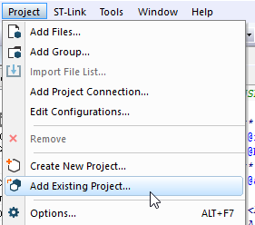
Using Firmware Examples with IAR
1.) Have IAR Embedded Workbench IDE launched.
2.) Load IAR with project: Project → Add Existing Project…

Slide 15
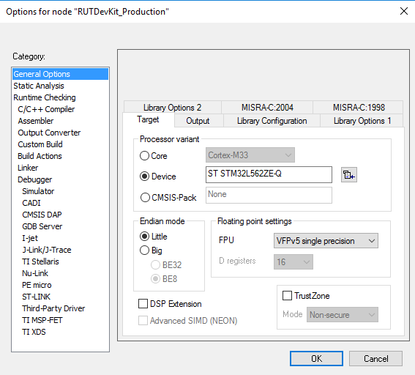
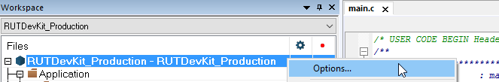
Using Firmware Examples with IAR
3.) Setup the target with right click on the imported project Options → General Options. Select target as STM32L562ZE-Q

Slide 16
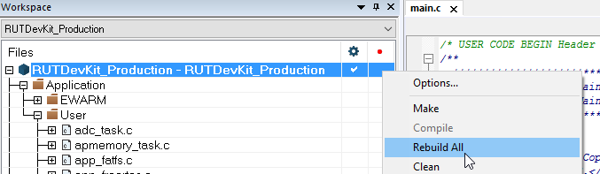
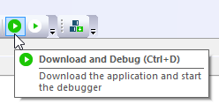
Using Firmware Examples with IAR
4.) Build the project.
5.) Download & Debug.

Slide 17
Starting New Project with CubeMX

Slide 18
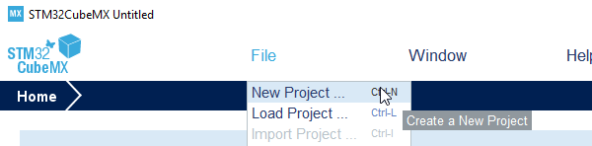
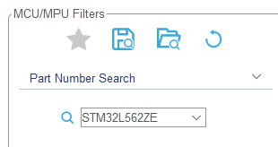
Starting New Project with CubeMX
1.) Have CubeMX software launched.
2.) Go for new projects creation File → New Project…
3.) Enter part number STM32L562ZE into the Part Number Search.

Slide 19
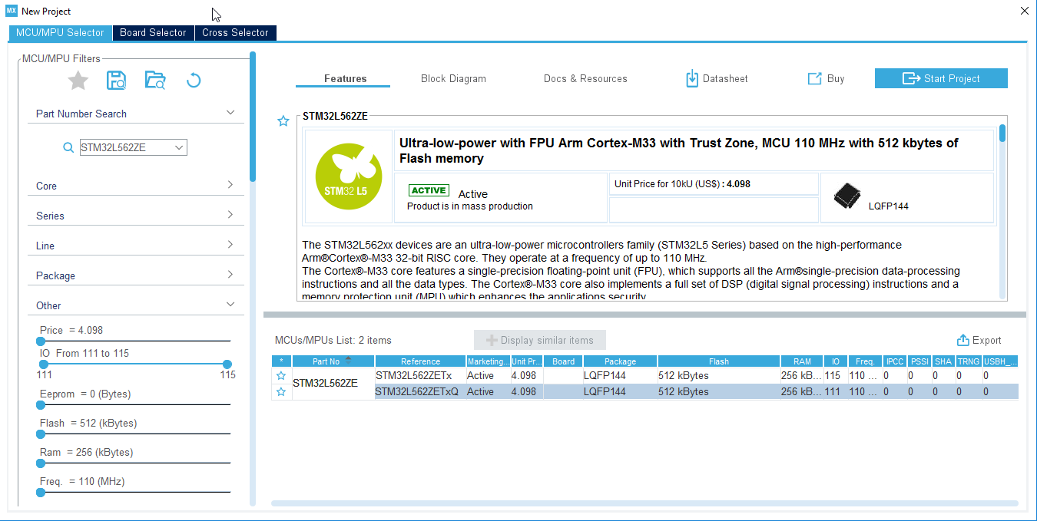
Starting New Project with CubeMX
4.) Select STM32L562ZETxQ part and press on Start Project.

Slide 20
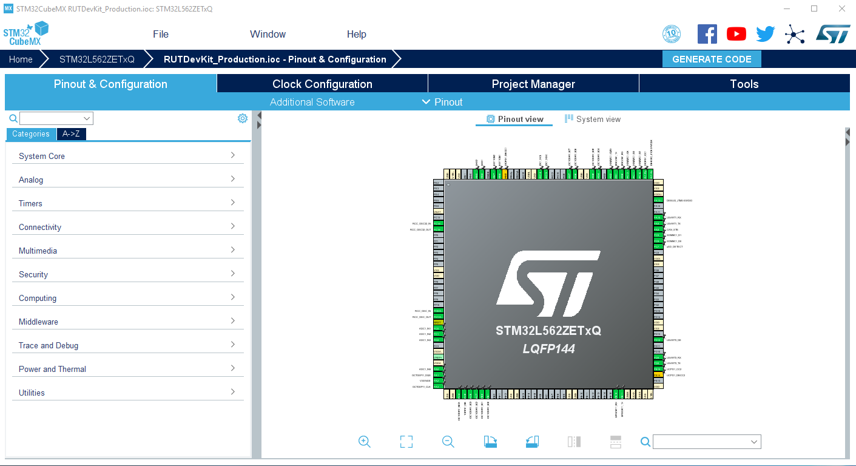
Starting New Project with CubeMX
5.) Configure Pinout and Clock according to yours application.

Slide 21
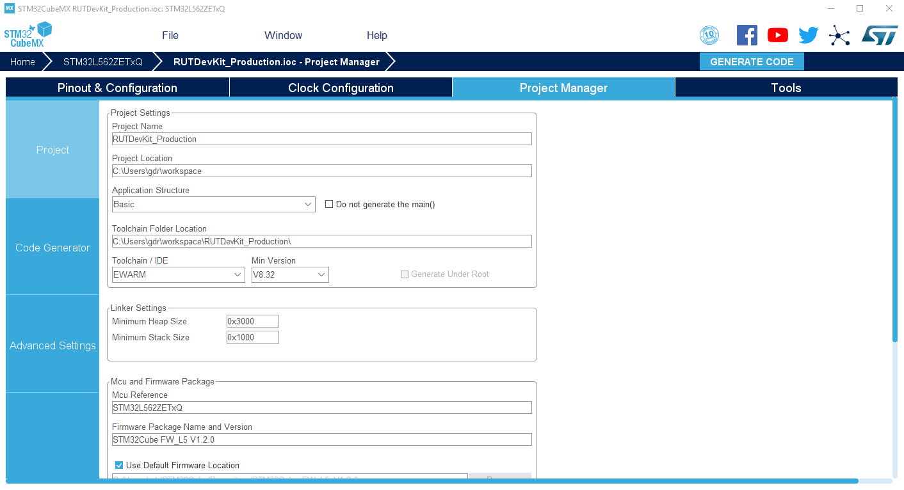
Starting New Project with CubeMX
6.) Select yours preferred toolchain or IDE and generate project.

Slide 22
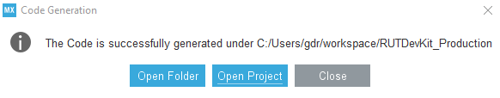
Starting New Project with CubeMX
Open generated project and start development…

Slide 23
Gintaras Drukteinis
Technical Support
Phone : +370 372 45568
eMail : gdr@rutronik.com

